Slide 1

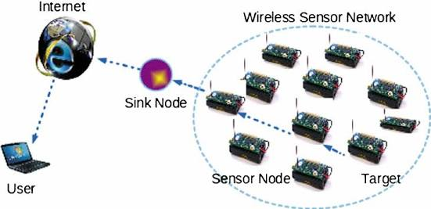
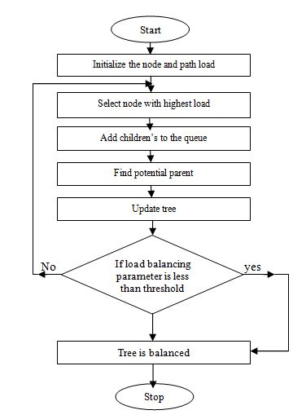
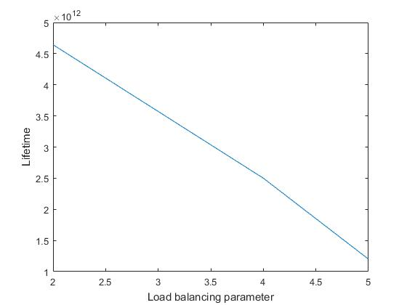
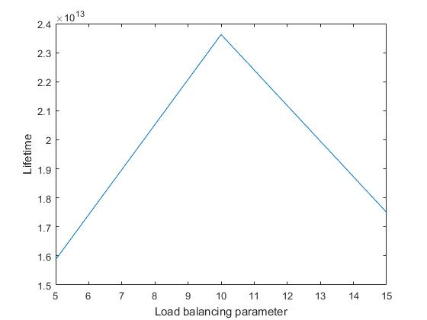
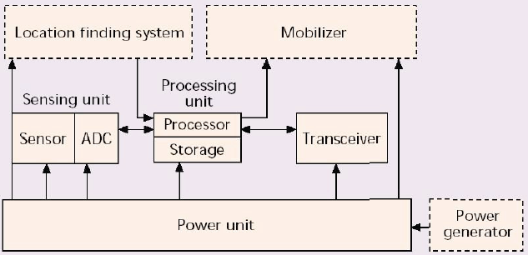

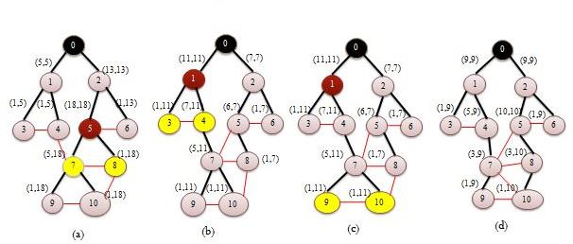
WIRELESS SENSOR NETWORK TECHNOLOGY
Author¹, Author²
Department of Information Technology, Walchand College of Engineering Sangli.Maharashtra
Abstract: Maximizing battery lifetime is the main concern in sensor network due to limited battery power. To enhance the lifetime of the network emphasis given to design energy efficient routing algorithms. In WSN, sensor nodes which are nearer to the base station having a task of collecting data for the entire area and send to the base station. These nodes have an additional load. To support such a collection of data tree topology is build at the sink node or base station. Load balancing method is used for distributing the workload over a sensor network. This paper contributes to maximizing the wireless sensor network duration applying the load balancing concept. This paper is focus on to reduce communication overhead and increase the convergence time using load balancing scheme which augments duration of the network considering different network parameter (e.g., density, degree) using randomized changing.
Introduction
Methodology
Result and Discussion
A Wireless Sensor Network (WSN) consists of base stations or sink nodes and a number of wireless sensors nodes. These sensors work with each other to sense some physical phenomenon and then the information gathered is processed to get relevant results.
This section presents an existing efficient routing algorithm for maximizing the lifetime of wireless sensor network considering load balancing [1] scheme. This algorithm searches bottleneck node and balances path loads of those nodes in the network through randomized changing [1] and transformation of the tree.
Energy loss rate : r_{i=}R^{t} _{i} E^{t} + R^{c} _{i} E^{c} _{..........…………..(1)}
Load of a node : γ = r_{i/} e_{i ……………………………………...(2)}
Lifetime of a node : t_{i =} e_{i/} r_{i……………………………..(3)}
This section evaluates the implementation of existing RaSMaLai [1] algorithm. The graph shows that when load balancing parameter is low then the lifetime of the network is increases i.e. battery level is more. Fig.6(a) and 6(b)shows the lifetime achieved by the steady state of the network containing 12 nodes and 100 nodes
Figure 1. Overview of sensor network
(a)
(b)
Figure 6. Impact of Load Balancing Parameter (a) for 12 nodes (b) for 100 nodes
Network is a connected graph which contains G= {V, E}, Where V is the set of vertices corresponding to the N sensor nodes and E is the edges between nodes. Tree topology [2] is used for deployment of N sensor nodes over the network.
Conclusion
Figure 2. Components of sensor node
1. Existing RaSMaLai [1] algorithm is useful for different scenarios rather than specific application.
2. This randomized switching [1] algorithm maximizes the lifetime of data collection tree.
Applications
Figure 4. Flowchart of RaSMaLai Algorithm
Future Scope
1. Different network parameters [1] (network density, degree of node) are considered to reduce the drawback of less decedents nodes for the switching.
2. Also focusing on to reduce communication overhead, and convergence time.
Figure 3. Different applications of sensors
Objectives
Following objectives are defined in proposed study:
1. To implement tree based topology using randomized switching.
2. To analyze the performance of tree based topology considering various parameters.
3. To extend tree based topology using cluster approach.
References
Figure 5. Illustrative example of switching process (a) tree at the h^{th} iteration
(b) Node 7 is switched (c) nodes 9 and 10 are selected (d) node 10 is switched
[1] S. K. A. Imon, A. Khan, M. Di Francesco, and S. K. Das, “Energy-efficient randomized switching for maximizing lifetime in tree-based wireless sensor networks,” IEEE/ACM Trans. Netw., vol. 23, no. 5, pp. 1401–1415, 2015.
[2] D. Luo, X. Zhu, X. Wu, and G. Chen, “Maximizing lifetime for the shortest path aggregation tree in wireless sensor networks,” Proc. - IEEE INFOCOM, pp. 1566–1574, 2011.
Notes:
1

